Slide 1
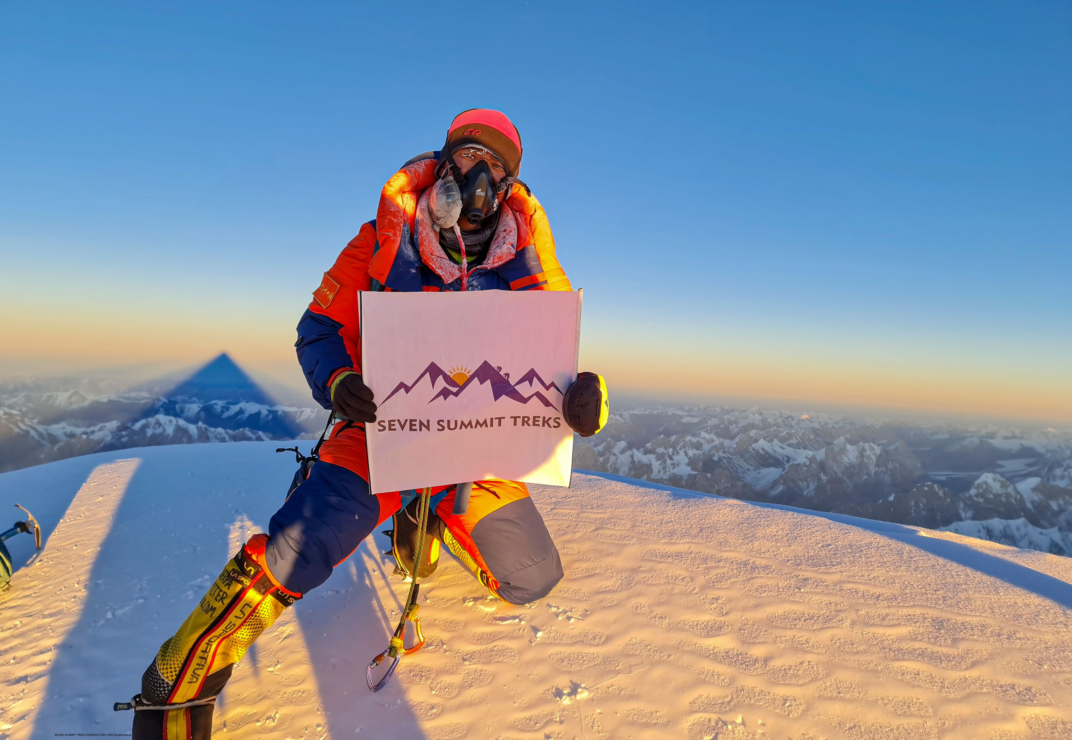

Slide 3
What is happening in the news this week?
A team of climbers from Nepal have become the first ever to summit the world’s second highest mountain, K2, in winter.
When did you last challenge yourself?
Learn more about this week’s story here.
Watch this week’s useful video here.
This week’s Virtual Assembly here.

Slide 4
How does it make me feel?
sad | angry | happy | confused | excited | worried | shocked | afraid
despondent disconsolate dismal doleful downhearted forlorn gloomy melancholic miserable woeful wretched | aggrieved annoyed discontented disgruntled distressed exasperated frustrated indignant offended outraged resentful vexed | beaming buoyant cheery contented delighted enraptured gleeful glowing joyful | addled baffled bemused bewildered disorientated indistinct muddled mystified perplexed puzzled | animated elevated enlivened enthusiastic exhilarated exuberant thrilled | agitated anxious apprehensive concerned disquieted distraught distressed disturbed fretful perturbed troubled uneasy | astonished astounded disconcerted distressed dumbfounded horrified staggered startled stunned surprised | alarmed apprehensive daunted fearful frantic horrified petrified terrified

Slide 5
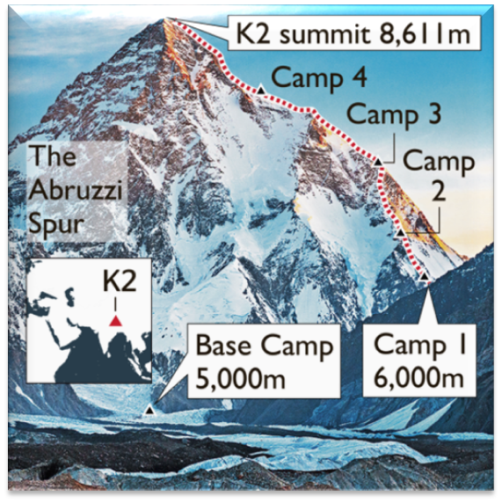
Assembly Resource
Read through the information below about K2 and the climbers’ recent ascent to the summit. What do you think would have been the hardest part of the climb? How do you think the climbers would have felt when they reached the summit?
K2 Fact file
K2 is found on the China-Pakistan border.
It is the second highest mountain in the world at 8611m (28251ft).
Known as the Savage Mountain, as it is very hard to climb, some believe harder than Mount Everest.
Source: TOL

Slide 6
Assembly Resource
Read through the information below about K2 and the climbers’ recent ascent to the summit. What do you think would have been the hardest part of the climb? How do you think the climbers would have felt when they reached the summit?
K2 Winter Climb
This year, the group of 10 Nepalese climbers were the first ever to tackle and successfully reach the summit of K2 in winter, when the temperatures can plummet to -80⁰F (-62⁰C)! Previously nobody had managed to get higher than 7650m in the winter months.
The final day of climbing took the group 16 hours and the whole team waited 10m below the summit to form a group, then stepped onto the summit together while singing the Nepalese national anthem.

Slide 7
Assembly Resource
Read through the information below about K2 and the climbers’ recent ascent to the summit. What do you think would have been the hardest part of the climb? How do you think the climbers would have felt when they reached the summit?
The impossible made possible!
History for mankind. History made for Nepal.
One of the climbers, Nirmal Purja.
Source: N Purja
Above: Nirmal Purja, pictured on K2 on an earlier climb in 2019.

Slide 8
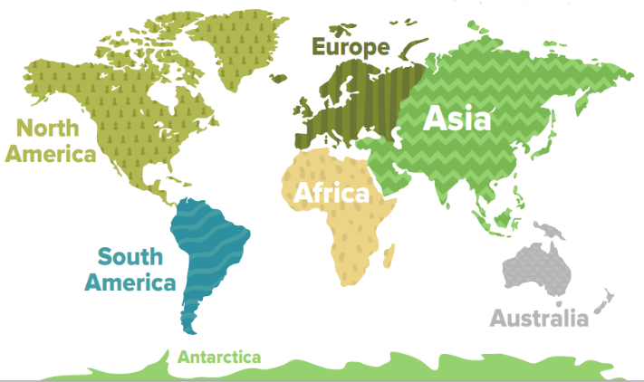
Resource 1
Look at the resource below, which shares some information about Mount Everest.
Mount Everest is in southern Asia. It is located in the Himalayan mountain range between Nepal and Tibet (China).

Slide 9
Resource 1
Look at the resource below, which shares some information about Mount Everest.
Did you know?
Mount Everest is about 8848 metres (29028 feet) high.
It was named in 1865 after British surveyor and geographer, Sir George Everest.
On average, it takes 2 months to climb Mount Everest.
The top of Mount Everest was first reached in 1953.
The average temperature is -37⁰C.

Slide 10
Resource 1
Look at the resource below, which shares some information about Mount Everest.
Does any of the information surprise you?
Is there anything else you would like to find out?

Slide 11
Resource 2
Look at the resource below, sharing information about four people who have climbed some of the world’s largest mountains.
What skills do you think they would need to succeed?
Siula Grande, Peruvian Andes

Slide 12
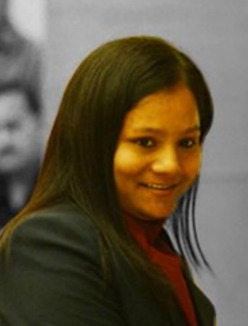
Resource 2
Look at the resource below, sharing information about four people who have climbed some of the world’s largest mountains.
Arunima Sinha
Arunima Sinha from India conquered Mount Everest, the highest mountain in the world above sea level, on 21st May 2013. She did so with a prosthetic leg after her left leg was amputated two years earlier.
Source: Dr. Arunima Sinha Twitter page

Slide 13
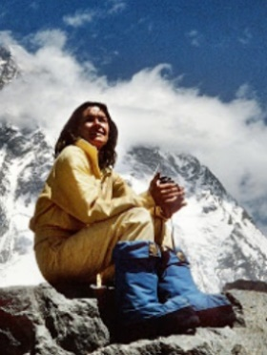
Resource 2
Look at the resource below, sharing information about four people who have climbed some of the world’s largest mountains.
Wanda Rutkiewicz
Source: @PolishHistory Twitter page
Wanda Rutkiewicz was a polish mountain climber, who became the first woman to reach the summit of K2 in 1986. She was also the third female to reach the summit of Everest in 1978. Sadly, she died in 1992, attempting to climb Kangchenjunga.

Slide 14
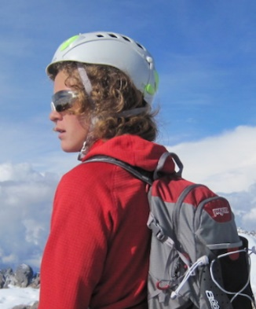
Resource 2
Look at the resource below, sharing information about four people who have climbed some of the world’s largest mountains.
Jordan Romero
Jordan Romero currently holds the title for the youngest person to reach the summit of Mount Everest. The American was 13 years and 10 months old when he made it to the top on 22nd May 2010.
Source: @SportKidsWear1 Twitter page

Slide 15
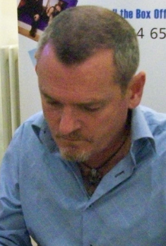
Resource 2
Look at the resource below, sharing information about four people who have climbed some of the world’s largest mountains.
Joe Simpson
Joe Simpson is a British mountaineer. In 1985, he climbed Siula Grande, via the hitherto unclimbed west face. On the decent, he fell through a crevice and suffered severe injuries. He was thought to be lost but he managed to crawl back down.
Source: summonedbyfells

Slide 16
Reflection
Over the course of our lives, we will face many mountains that we will need to overcome. Some we may choose, others not but we must always remember to try our best and keep going until we get to the top!

Slide 19
This week’s useful vocabulary. Can you use any of them in your writing this week?
Ascent – an upward journey, especially when walking or climbing.
Perseverance – continuing with something even though it is difficult.
Recent – having happened, begun or being done only a short while ago.
Sub-zero – lower than 0, below freezing.
Summit – the highest point of a hill or mountain.
Tackle – making determined efforts to deal with a problem or difficult task.

